Slide 1

Alert Watch and Response Engine (AWARE)
Quality Improvement (QI) Tool Training
Ralph H Johnson VA Medical Center
Charleston, SC
June 2014
CLIN 0009AC

Slide 2
Contents
Lesson 1: What Is the QI Tool?
Overview of the QI Tool
System/Configuration Requirements
Lesson 2: Using the QI Tool
Logging In and Out
Viewing Reports
Understanding Reports
Lesson 3: Using the Super User Menu
Accessing the Super User Administrative Menu
Managing QI Tool Groups
Managing VistA Groups
Managing Users
Managing Reports
Contact Information

Slide 3
Purpose and Objectives
Objective: To provide an overview, basic training, and examples of how to access and use the QI Tool
After completing this training:
All Users should be able to view and generate reports for critical alerts using the QI Tool
Super Users should be able to manage QI Tool groups, users, and reports

Slide 4
Lesson 1: What Is the QI Tool?

Slide 5
Overview
A web-based tool to sort, categorize, and review critical alerts and the rate of follow-up actions by provider, clinic, or facility
Primary users:
Patient safety managers and officers
Clinicians and clinician supervisors
Additional potential users:
Department Chiefs
Care Coordinators

Slide 6
User Access Levels
“Normal” User:
Clinicians
Are able to view and generate reports for their own alert history only
Super User:
Patient Safety Officers
To be a Super User, the user must have their VA network logon ID stored in the AWARE SQL Server QI Manager web.config file
Super Users are able to view and generate reports for all historical alerts, regardless of owner

Slide 7
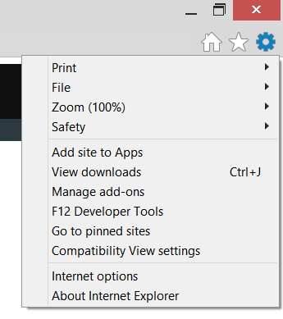
System/Configuration Requirements
The QI Tool has been developed to be compatible with Internet Explorer up to version 11 (IE 11).
However, on IE 11, Compatibility View must be configured in order to load reports.
To configure Compatibility View:
Click on the “Gear” icon in the upper-right hand corner of IE 11 to display the Tools menu.
Click on Compatibility View Settings.
The Compatibility View Settings window should then appear.
IE 11 Tools Menu

Slide 8
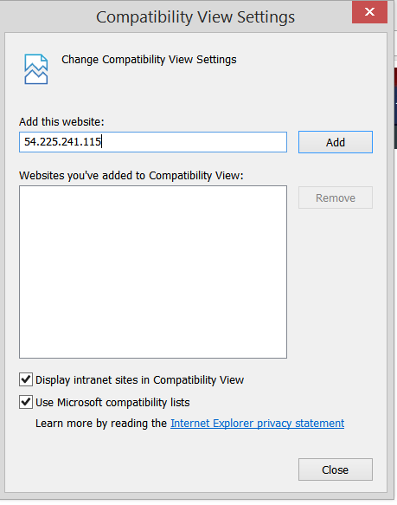
System/Configuration Requirements
The IP address for the QI Tool should automatically appear in the Add this Website field in the Compatibility View Settings window.
Click Add to add this IP address to Compatibility View.
Click Close.
Close and restart your browser.
Compatibility View Settings Window

Slide 9
Lesson 2: Using the QI Tool

Slide 10
Logging In and Out

Slide 11
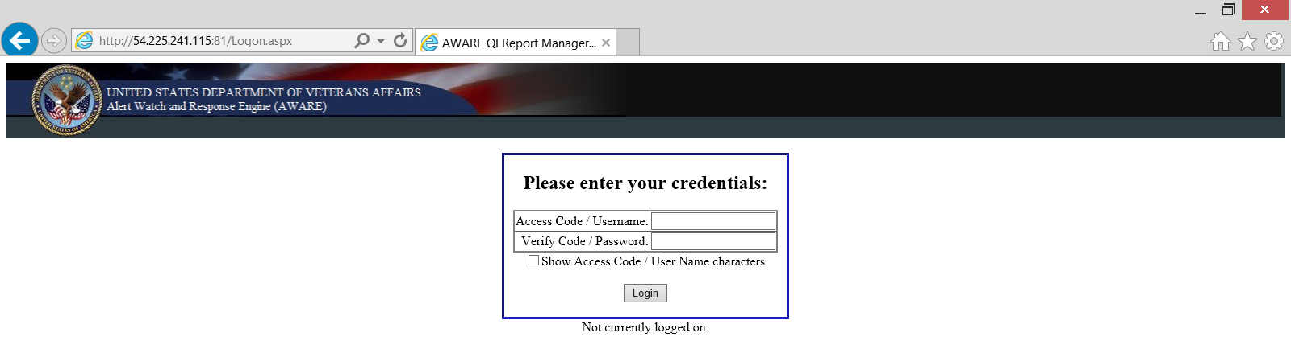
Logging In
Open a web browser and navigate to [URL].
You should then see the page below:
QI Tool Login Page

Slide 12
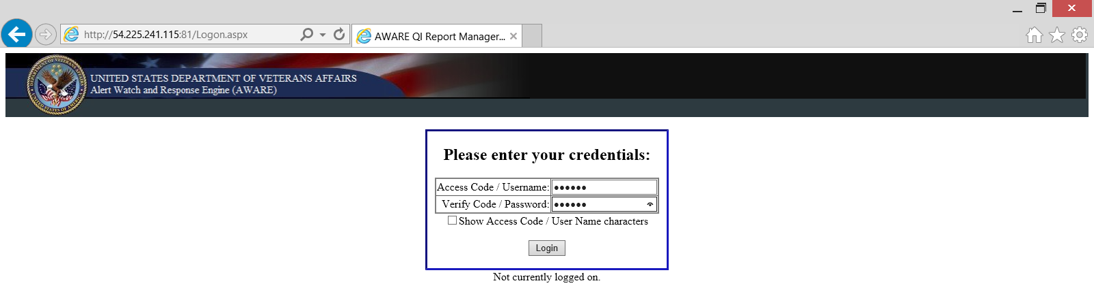

Logging In
Type your Access Code and Verify Code into the fields.
(Optional): Click the Show Access Code / User Name Characters checkbox to remove the masking if you need to check what you have typed in.
QI Tool Login Page

Slide 13
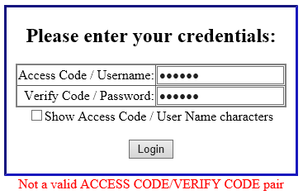
Logging In
Click Login.
Note: If your login information is incorrect, you will see the following message.
QI Tool Login Page

Slide 14
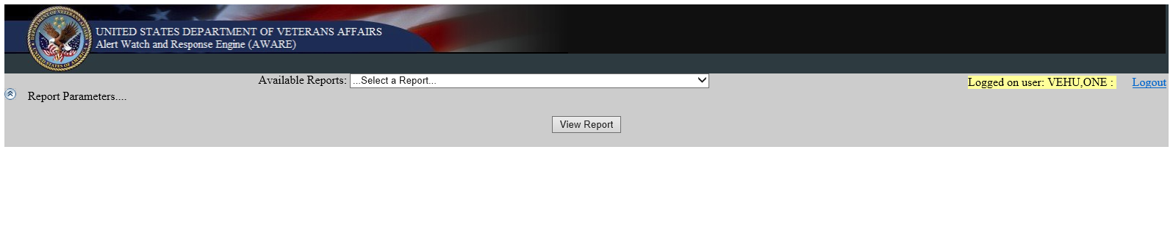
Logging In
Upon successfully logging in, you should see this page.
QI Tool Main Page

Slide 15
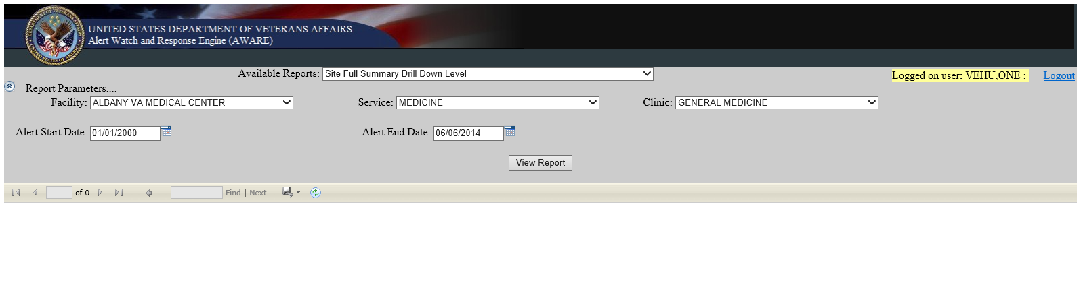
Logging Out
To log out, Click the Logout link in the upper-right corner.
QI Tool Main Page

Slide 16
Viewing Reports

Slide 17
Viewing Reports
Once logged in, you can view historical alert data using reports.
The different reports that are available are created, named, and configured by Super Users and Clinical Application Coordinators (CACs).
Below are some examples of the reports that may be included in your installation of the QI Tool.
Note: The reports available at your site may differ from those shown.
Provider Full Report | Displays all the Alerts for a single Provider, allowing you to drill down by facility, service, clinic, provider, alert type, and/or date range.
Provider Full Report > 7 Days | Displays all the Alerts for a single Provider, where follow-up (if any) was made past 7 days of alert occurrence, and allowing you to drill down by facility, service, clinic, provider, alert type, and/or date range.
Provider Summary Report | Displays provider summary data, including Mean Alerts/Month, where follow-up (if any) was made past 7 days of alert occurrence, and allowing you to drill down by facility, service, clinic, provider, alert type, and/or date range.
Facility All Service/Clinics Summary Report | Displays summary data, including SubTotal/Total Percentages of Alerts generated within a Facility for multiple (or all) Services and multiple (or all) clinics, among all Alert Types, where follow-up (if any) was made past 7 days of alert occurrence.

Slide 18
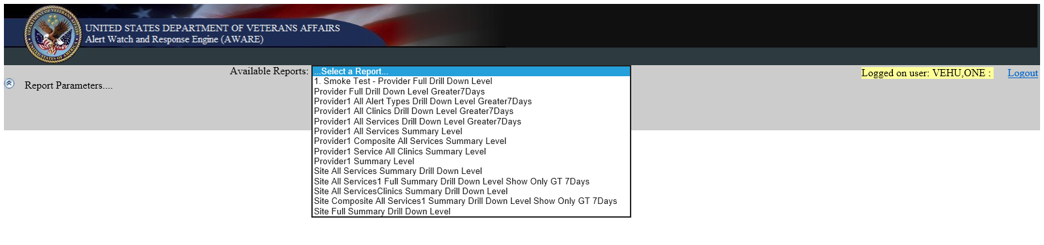
Viewing Reports
To begin viewing a report, click on the Available Reports dropdown.
Click on a report you wish to view.
Note: The reports available at your site may differ from those shown.
QI Tool Available Reports Dropdown

Slide 19
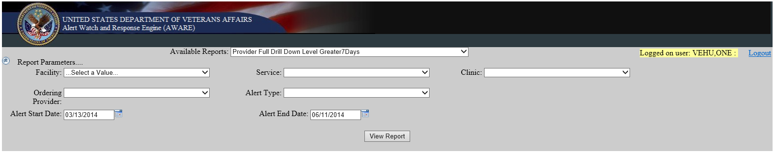
Viewing Reports
After selecting a report to view, the Report Parameters area will appear.
Note: If the Report Parameters area down not appear, it may be hidden; click the arrow icon next to the words Report Parameters to make display the area.
QI Tool Report Parameters
Click the arrow icon to display or hide the Report Parameters area

Slide 20
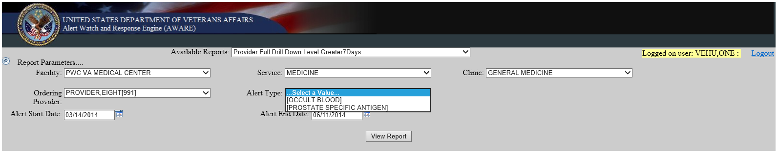
Viewing Reports
Use the dropdowns to set the report parameters, such as which facility, service, clinic, provider, and alert type to view.
Note: Other than the Alert Start Date and Alert End Date parameters, all other parameters must be set in order, from left to right, top to bottom.
QI Tool Report Parameters

Slide 21
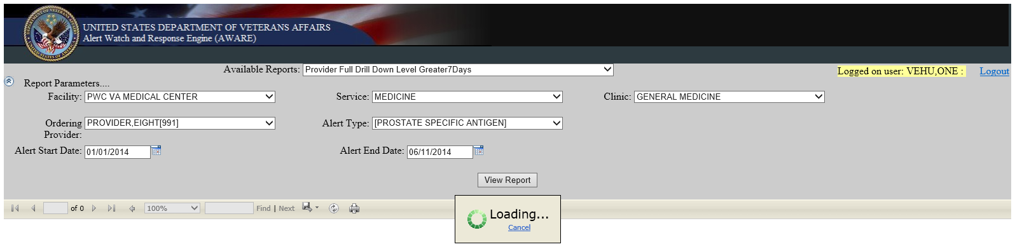
Viewing Reports
Click View Report to display the report.
Note: The report may take a moment to load.
QI Tool Report Loading

Slide 22
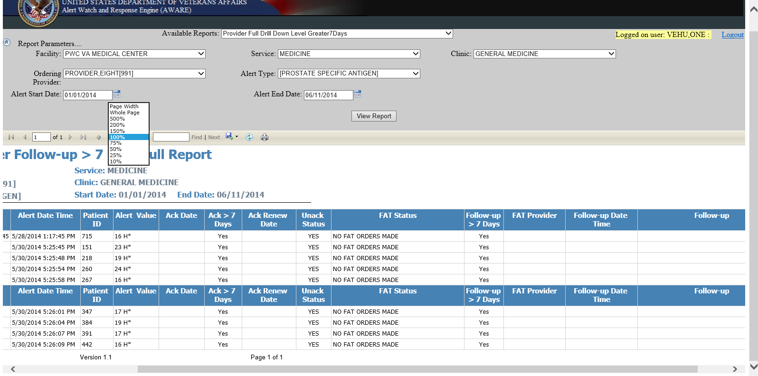
Viewing Reports
Use the scrollbars to view more of the report.
Alternatively, you can click the Zoom dropdown to increase or decrease the zoom level of the report, click the Save icon to save the report to several file formats, and/or click the Print icon to print the report.
Save icon
Zoom dropdown
Print icon
Scrollbars
Scrollbars
QI Tool Report

Slide 23
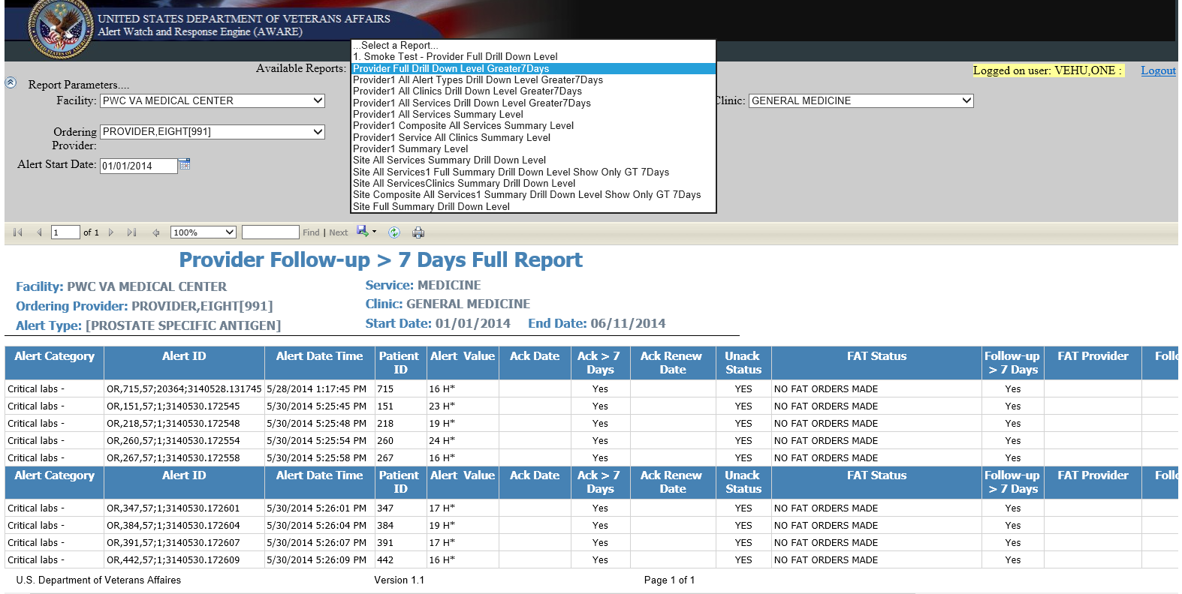
Viewing Reports
To view another report, simply click on the dropdown for Available Reports and choose another report to view.
QI Tool Report

Slide 24
Understanding Reports

Slide 25
Understanding Reports
Each of the reports available in the QI Tool have different data fields, depending on which report you are viewing.
The tables on the following slides explain what these data fields represent.
Alert Type Orig Station | The site number of the VA facility where the Alert Type was created
Follow-up | Indicates whether or not follow-up action(s) have been performed for this alert
Follow-up > 7 Days | “Yes” means more than 7 days have passed since the alert was made and no follow-up has been posted. “No” means that either follow-up was posted within 7 days from the date the alert was generated, or 7 days have not yet passed since alert generation.
Ack > 7 Days | This field indicates whether or not the date of acknowledging the alert is past 7 days from generation
Alert Value | Indicates the actual value of the alert (abnormal, positive, etc.)

Slide 26
Understanding Reports
Alert ID | The Alert Tracking Name field
Date | The date and time the alert was created
Service | The name of the service or section for the Alert Recipient
Ordering Provider | The provider who generated the alert
Alert Recipient | The recipient(s) of the alert, such as the Ordering Provider, Lab Tech, Radiologist, or OR/RR Team
Alert Category | The Alert Category, which determines the notification type
Alert Type | The Alert Type name stored in Alert Display Text
UN_ACK Status | Indicates whether or not the Alert has a Processed Alert Date and Deleted Date.
ACK Renew Date | This date identifies the renewed date for needed acknowledgement after no follow-up action taken has been determined upon provider processing of the alert.
Delete Date | The Alert Deleted Date (date of acknowledgement)
FAT Status | This field indicates whether FAT Orders/Follow-ups have been made.
FAT Provider | If FAT Orders/Follow-ups have been made, this field will contain the provider who did the required follow-up action(s) defined for this alert type.
Follow-up Provider | The provider who performed follow-up action(s) on the alert, not necessarily the same person as the ordering provider
Clinic | The hospital location from which the order originated
Patient ID | The Patient DFN indicated by the alert

Slide 27
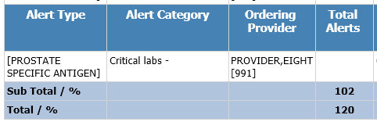
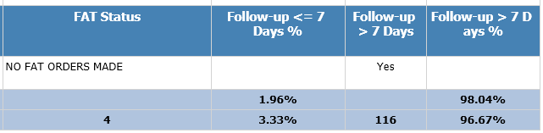
Understanding Reports
Some reports have summary data at the bottom of the report showing the total number of alerts or instances of follow-up over the date range specified for the report, or the mean percentage of instances of follow-up.
QI Tool Summary Data

Slide 28
Lesson 3: Using the Super User Menu

Slide 29
Accessing the Super User Administrative Menu

Slide 30
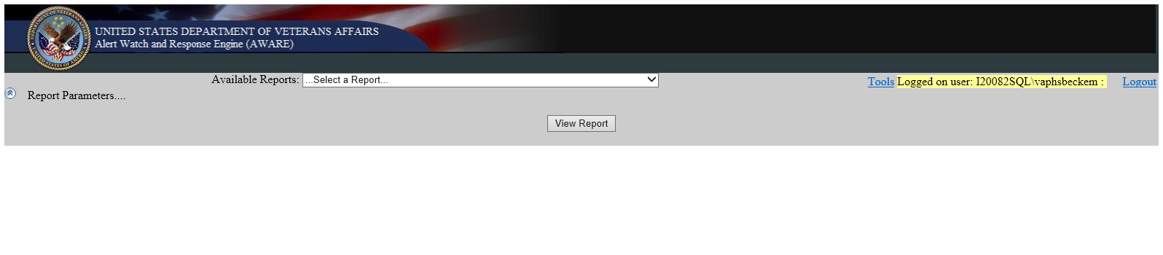
Accessing the Super User Administrative Menu
Super Users will see a slightly different page in the QI Tool upon logging in. There will be an additional link called Tools.
QI Tool Main Page, logged in as Super User

Slide 31
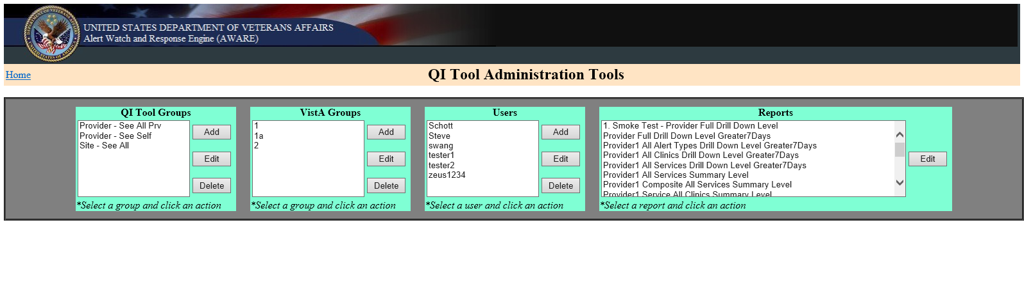
Accessing the Super User Administrative Menu
Click on the Tools link to display the QI Tool Administration Tools Page.
QI Tool Administration Tools Page

Slide 32
Overview of the Super User Administrative Menu
The Super User Administrative Menu allows you to manage (Add/Edit/Delete) user access to the QI Tool and what data they can view.
Manage the names of reports and how they display in the QI Tool
Manage groups and what reports they can view in the QI Tool
Manage VistA groups linked to QI Tool Groups
Manage users and their access to the QI Tool
QI Tool Administration Tools (the Super User Administrative Menu)

Slide 33
Managing Qi Tool Groups

Slide 34
Managing QI Tool Groups
The QI Tool Groups area allows you to create groups of users and configure which reports they have access to.
QI Tool Administration Tools (the Super User Administrative Menu)

Slide 35
Adding a QI Tool Group

Slide 36
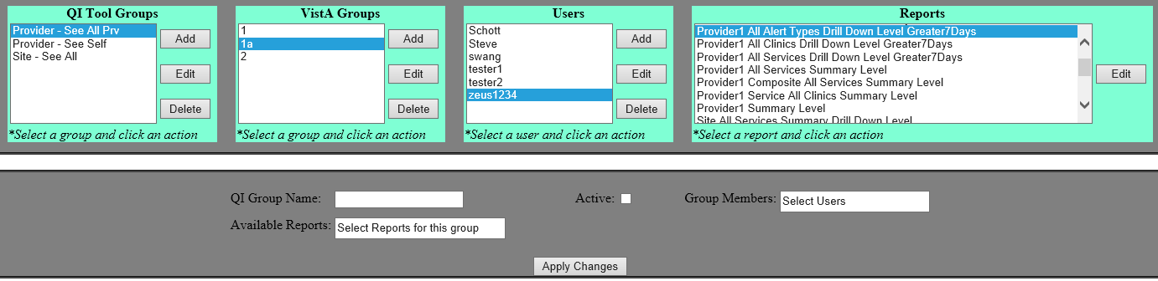
Adding a QI Tool Group
To add a QI Tool Group, first click on the Add button.
This will change the system to Add Mode. You’ll know it is in Add Mode when the QI Group Name field is cleared.
Click the Add button and the QI Group Name clears
Click the Add button and the QI Group Name clears
QI Tool Administration Tools (the Super User Administrative Menu)

Slide 37
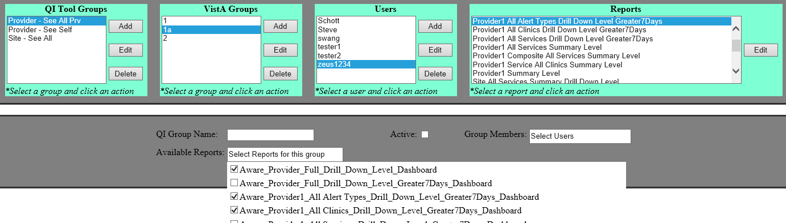
Adding a QI Tool Group
Click the Available Reports field to show the available reports in a dropdown.
Click the checkboxes to select which reports this QI Tool Group should have access to.
Note: Click outside the dropdown (for example, the grey area) to close the dropdown.
QI Tool Administration Tools (the Super User Administrative Menu)

Slide 38
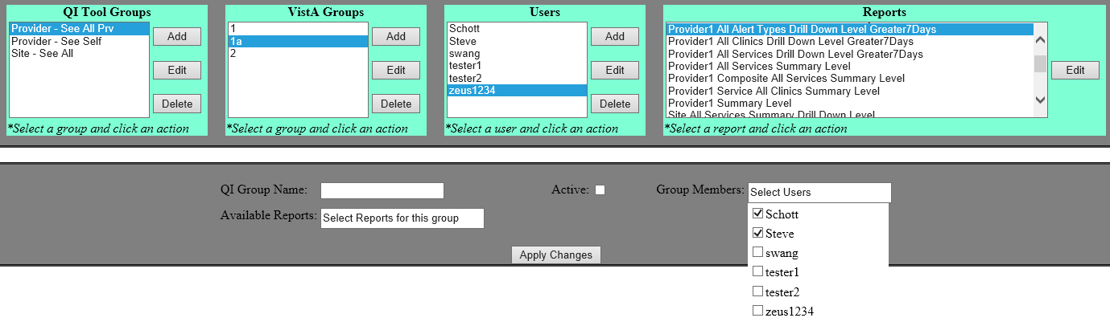
Adding a QI Tool Group
Click the Group Members field to show the available users in a dropdown.
Click the checkboxes to select which users should be part of this QI Tool Group.
Note: Click outside the dropdown (for example, the grey area) to close the dropdown.
QI Tool Administration Tools (the Super User Administrative Menu)

Slide 39
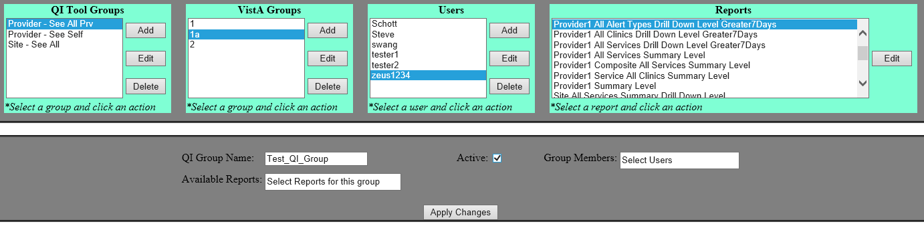
Adding a QI Tool Group
Click and enter a name into the QI Group Name field to name your new QI Tool Group.
Click the Active checkbox to mark this as an active QI Tool Group.
When you are finished configuring the group, click Apply Changes to create it.
QI Tool Administration Tools (the Super User Administrative Menu)

Slide 40
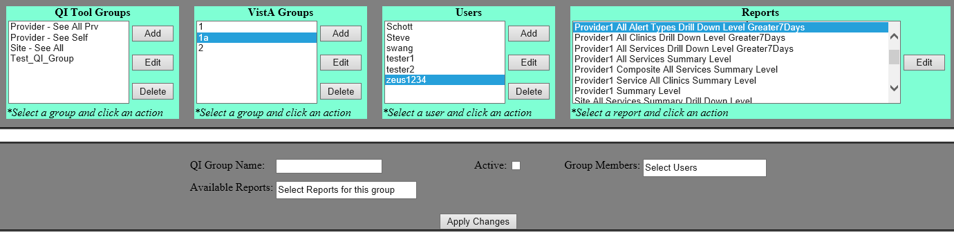
Adding a QI Tool Group
Your new QI Tool Group will appear in the QI Tool Groups area.
QI Tool Administration Tools (the Super User Administrative Menu)

Slide 41
Editing a QI Tool Group

Slide 42
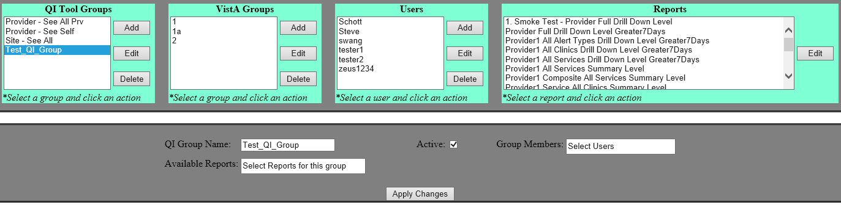
Editing a QI Tool Group
Editing existing QI Tool Groups works in a similar fashion to creating a new group.
First, select the existing QI Tool Group that you want to edit and click on the Edit button.
This will change the system to Edit Mode. You’ll know it is in Edit Mode when the QI Tool Group name you selected is shown in the QI Group Name field.
Click the Edit button and selected QI Group appears
Click the Edit button and selected QI Group appears
QI Tool Administration Tools (the Super User Administrative Menu)

Slide 43
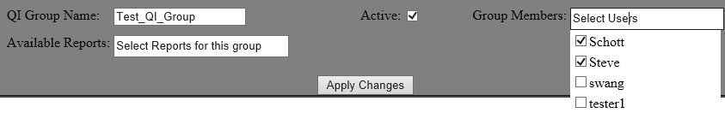
Editing a QI Tool Group
Once in Edit Mode, you can name the QI Tool Group, make the group active or inactive, add or remove group members, and configure which reports they have access to. These controls are explained in Adding a QI Tool Group.
When you are finished, click Apply Changes to save your changes.
QI Tool Group Controls

Slide 44
Deleting a QI Tool Group

Slide 45
Deleting a QI Tool Group
QI Tool Groups can be deleted.
First, select the existing QI Tool Group that you want to delete and click on the Delete button.
QI Tool Administration Tools (the Super User Administrative Menu)

Slide 46
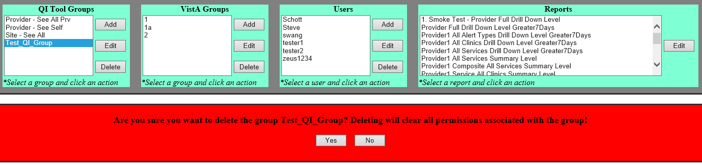
Deleting a QI Tool Group
A warning message will appear asking you to confirm the deletion.
Click Yes to delete the QI Tool Group you have selected. Alternatively, click No to remove the warning message and retain the group.
QI Tool Group Deletion Warning Message

Slide 47
Managing VistA Groups

Slide 48
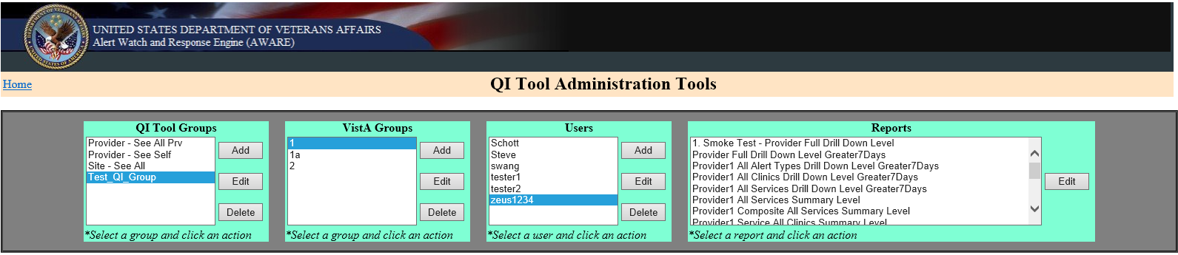
Managing VistA Groups
The VistA Groups area allows you Manage VistA groups linked to QI Tool Groups at a facility and configure their permissions.
Note: The ability to select a facility is intended for future use and is not fully implemented at this time.
Also note: Currently, the only possible VistA groups are 1 (view own provider’s alerts) and 2 (view all providers’ alerts).
QI Tool Administration Tools (the Super User Administrative Menu)

Slide 49
Adding a VistA Group

Slide 50
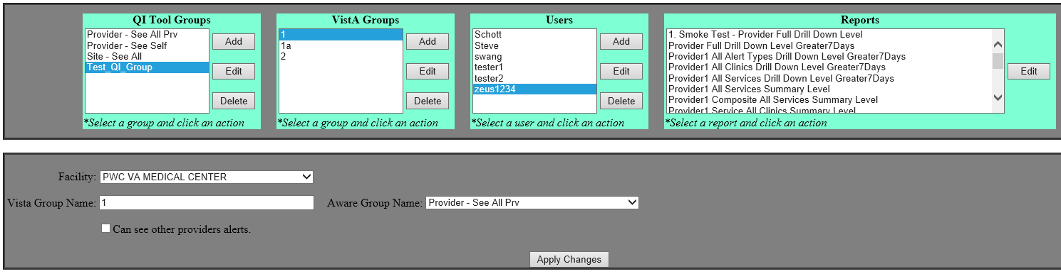
Adding a VistA Group
To add a VistA Group, first click on the Add button.
This will change the system to Add Mode.
Note: Currently, the only possible VistA groups are 1 (view own provider’s alerts) and 2 (view all providers’ alerts).
QI Tool Administration Tools (the Super User Administrative Menu)

Slide 51
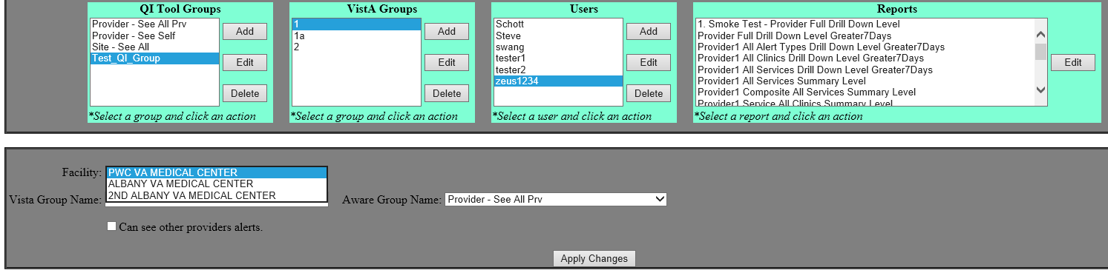
Adding a VistA Group
Click the Facility field to show the available facilities in a dropdown.
Click a facility from the dropdown to select which one this VistA group applies to.
Note: The ability to select a facility is intended for future use and is not fully implemented at this time.
Also note: Click outside the dropdown (for example, the grey area) to close the dropdown.
QI Tool Administration Tools (the Super User Administrative Menu)

Slide 52
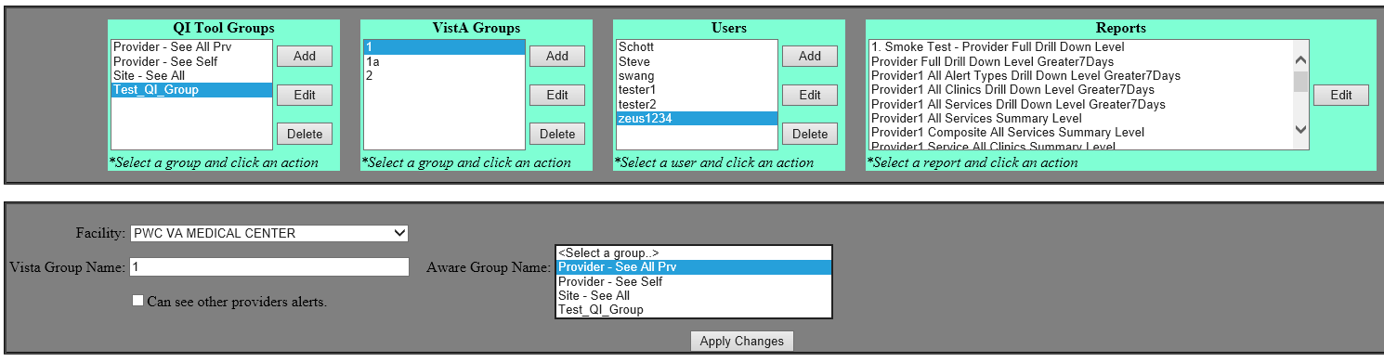
Adding a VistA Group
Click the Aware Group Name field to show the available QI Tool Groups in a dropdown.
Click a QI Tool Group from the dropdown to select which one should be associated with this VistA Group.
Note: Currently, the only possible VistA groups are 1 (view own provider’s alerts) and 2 (view all providers’ alerts).
Also note: Click outside the dropdown (for example, the grey area) to close the dropdown.
QI Tool Administration Tools (the Super User Administrative Menu)

Slide 53
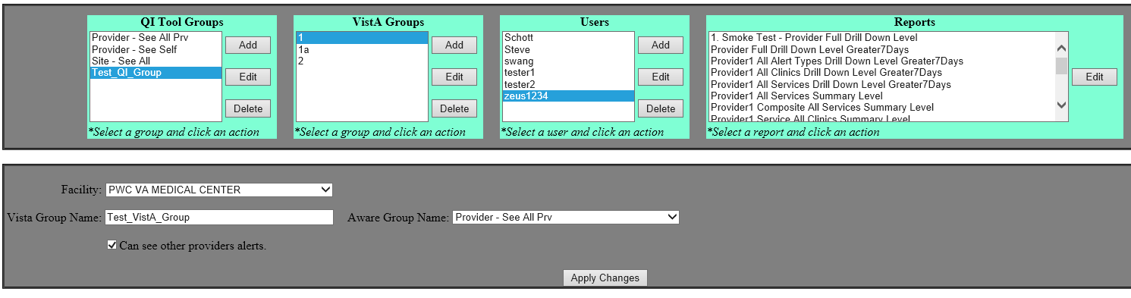
Adding a VistA Group
Click the Can see other providers alerts checkbox to allow this group of users to see both their own and other providers’ alerts.
When you are finished configuring the group, click Apply Changes to create it.
QI Tool Administration Tools (the Super User Administrative Menu)

Slide 54
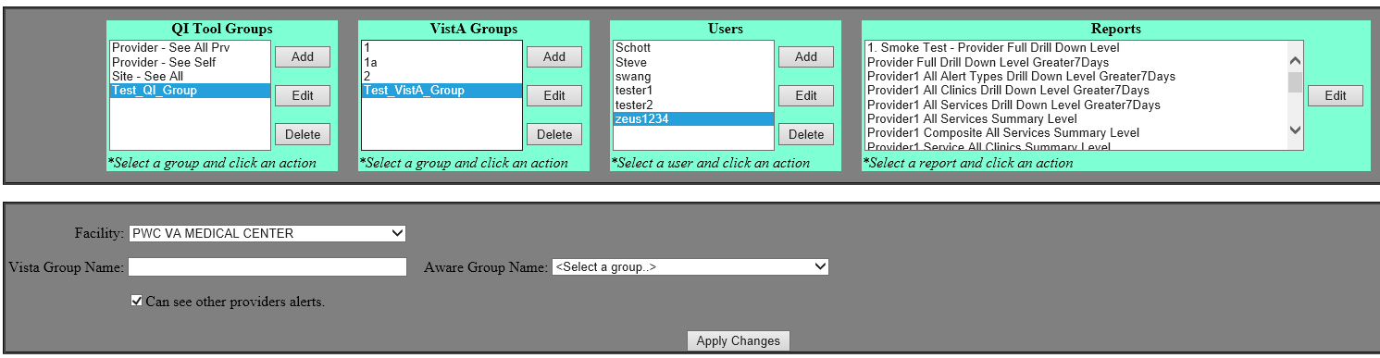
Adding a VistA Group
Your new VistA Group will appear in the VistA Groups area.
QI Tool Administration Tools (the Super User Administrative Menu)

Slide 55
Editing a VistA Group

Slide 56
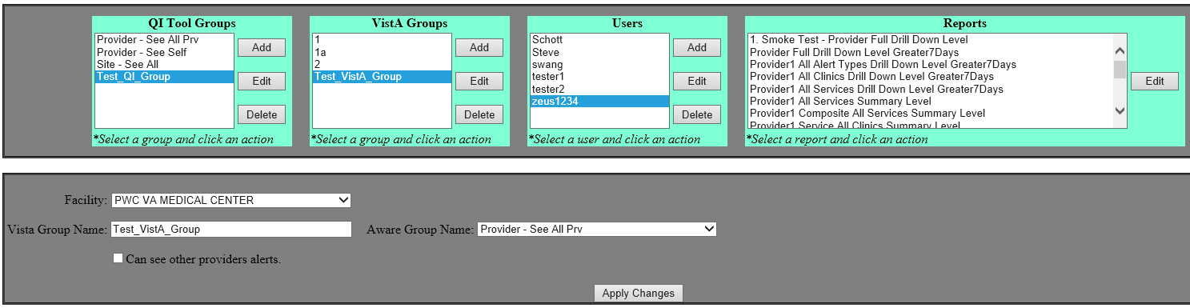
Editing a VistA Group
Editing existing VistA Groups works in a similar fashion to creating a new group.
First, select the existing VistA Group that you want to edit and click on the Edit button.
This will change the system to Edit Mode. You’ll know it is in Edit Mode when the VistA Group name you selected is shown in the Vista Group Name field.
Click the Edit button and selected VistA Group appears
Click the Edit button and selected VistA Group appears
QI Tool Administration Tools (the Super User Administrative Menu)

Slide 57
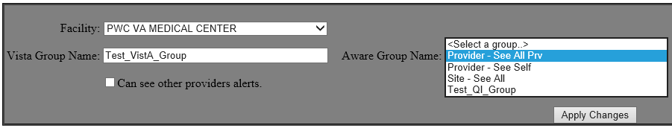
Editing a VistA Group
Once in Edit Mode, you can name the VistA Group, allow or disallow the viewing of other providers’ alerts, and select which facility and QI Tool Group the VistA Group applies to. These controls are explained in Adding a VistA Group.
When you are finished, click Apply Changes to save your changes.
VistA Group Controls

Slide 58
Deleting a VistA Group

Slide 59
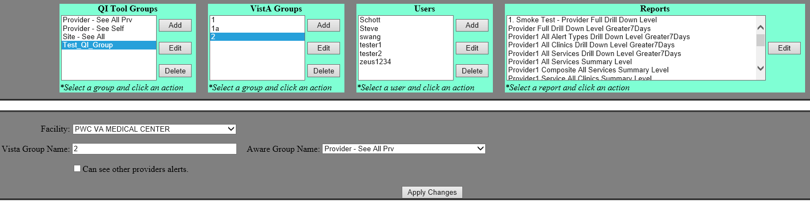
Deleting a VistA Group
VistA Groups can be deleted.
First, select the existing VistA Group that you want to delete and click on the Delete button.
QI Tool Administration Tools (the Super User Administrative Menu)

Slide 60
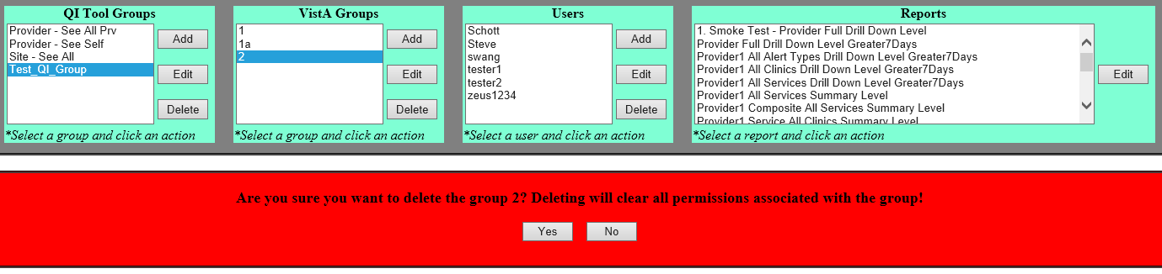
Deleting a VistA Group
A warning message will appear asking you to confirm the deletion.
Click Yes to delete the VistA Group you have selected. Alternatively, click No to remove the warning message and retain the group.
VistA Group Deletion Warning Message

Slide 61
Managing Users

Slide 62
Managing Users
The Users area allows you to add users, indicate which facility they are associated with, and assign them Verify Codes.
Note: Added users are considered local users. Normally these local users either do not have VistA login access and verify codes, or they belong to a VistA group but need additional privileges defined for that VistA group.
QI Tool Administration Tools (the Super User Administrative Menu)

Slide 63
Adding a User

Slide 64
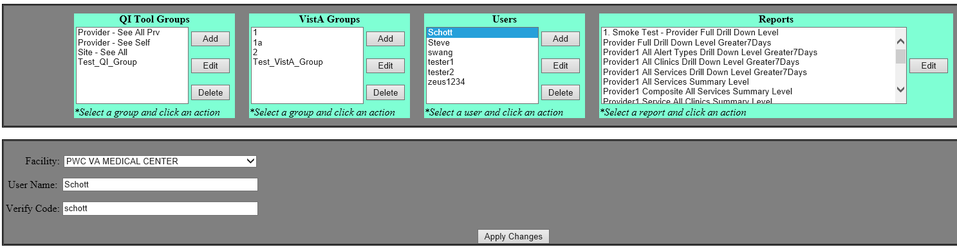
Adding a User
To add users, first click on the Add button.
This will change the system to Add Mode.
QI Tool Administration Tools (the Super User Administrative Menu)

Slide 65
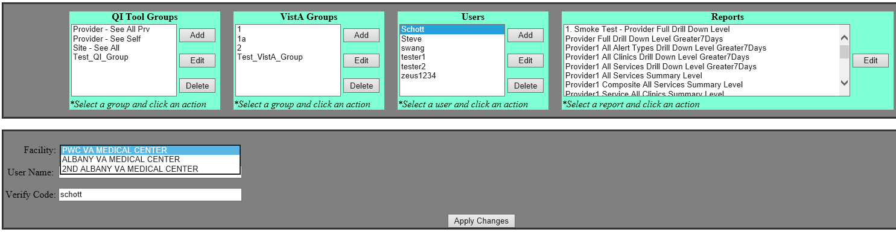
Adding a User
Click the Facility field to show the available facilities in a dropdown.
Click a facility from the dropdown to select which one applies to this user.
Note: Click outside the dropdown (for example, the grey area) to close the dropdown.
QI Tool Administration Tools (the Super User Administrative Menu)

Slide 66
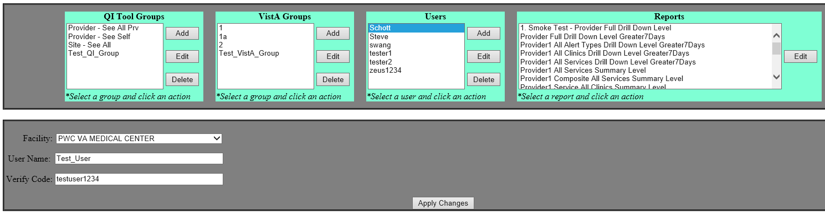
Adding a User
Click and enter a name into the User Name field. The user will use this when logging in.
Click and enter a name into the Verify Code field to assign a Verify Code for the user to use when logging in. The Verify Code will be encrypted on the server.
When you are finished configuring the user, click Apply Changes to create it.
QI Tool Administration Tools (the Super User Administrative Menu)

Slide 67
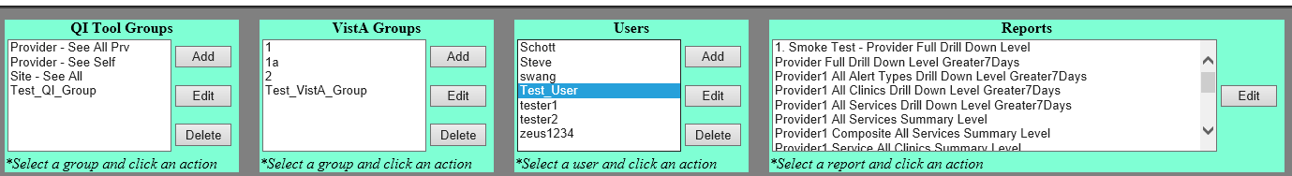
Adding a User
The new user will then appear in the Users area.
QI Tool Administration Tools (the Super User Administrative Menu)

Slide 68
Editing a User

Slide 69
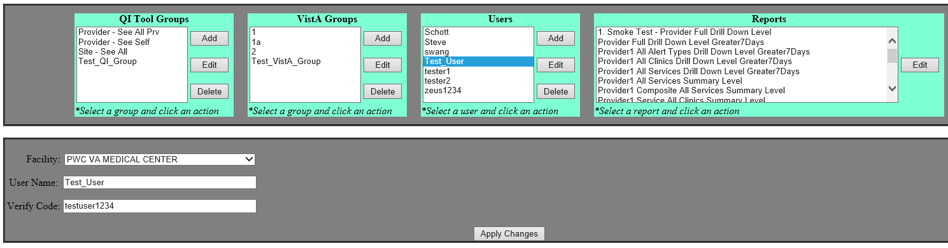
Editing a User
Editing existing users works in a similar fashion to creating a new user.
First, select the existing user that you want to edit and click on the Edit button.
This will change the system to Edit Mode. You’ll know it is in Edit Mode when the user name you selected is shown in the User Name field below.
Click the Edit button and selected user appears
Click the Edit button and selected user appears
QI Tool Administration Tools (the Super User Administrative Menu)

Slide 70
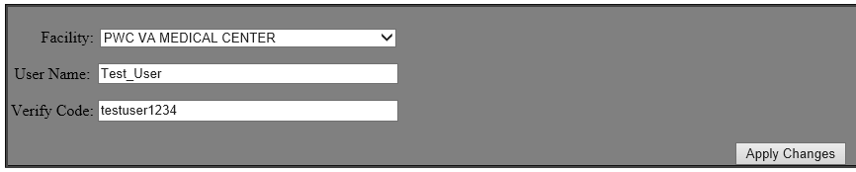
Editing a User
Once in Edit Mode, you can change the associated facility, change the user’s User Name, and assign the user a new Verify Code. These controls are explained in Adding a User.
When you are finished, click Apply Changes to save your changes.
User Management Controls

Slide 71
Deleting a User

Slide 72
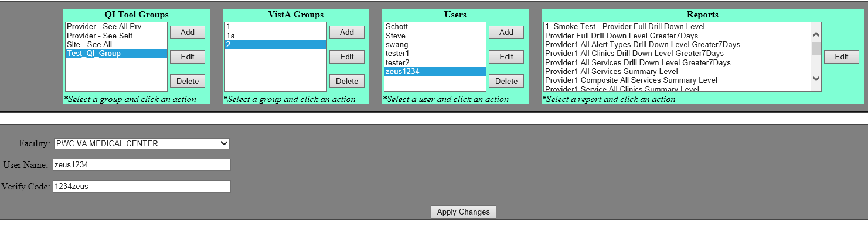
Deleting a User
Users can be deleted.
First, select the existing user that you want to delete and click on the Delete button.
QI Tool Administration Tools (the Super User Administrative Menu)

Slide 73
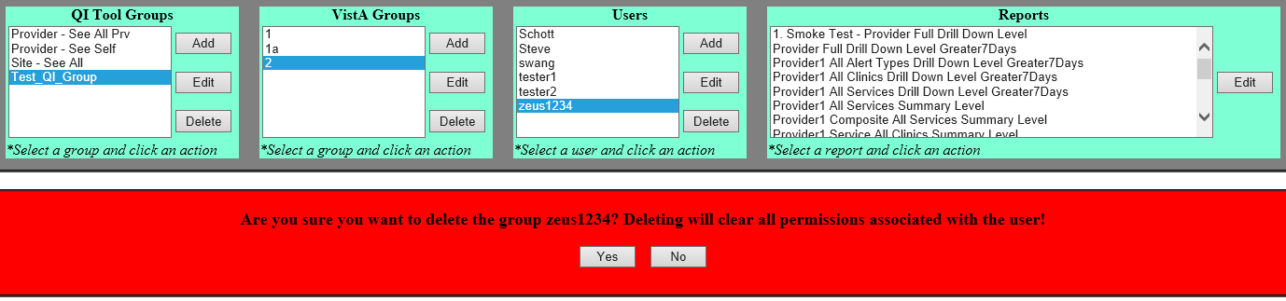
Deleting a User
A warning message will appear asking you to confirm the deletion.
Click Yes to delete the user you have selected. Alternatively, click No to remove the warning message and retain the user.
User Deletion Warning Message

Slide 74
Managing Reports

Slide 75
Managing Report
The Reports area allows you to see which reports are available and rename them.
QI Tool Administration Tools (the Super User Administrative Menu)

Slide 76
Editing a Report

Slide 77
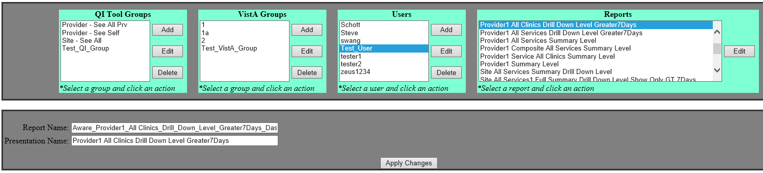
Editing a Report
To edit a report, first select the existing report that you want to edit and click on the Edit button.
This will change the system to Edit Mode.
QI Tool Administration Tools (the Super User Administrative Menu)

Slide 78
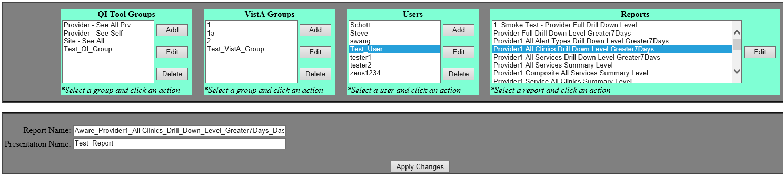
Editing a Report
Click and enter a name into the Presentation Name field to rename the report.
When you are finished editing the report, click Apply Changes to save your changes.
QI Tool Administration Tools (the Super User Administrative Menu)

Slide 79
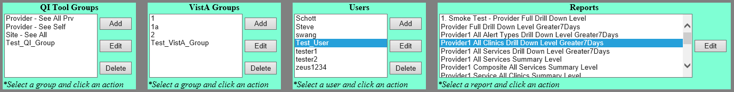
Editing a Report
The report’s name will then be changed in the Reports area.
QI Tool Administration Tools (the Super User Administrative Menu)

Slide 80
Contact Information

Slide 81
Contact Information
If you have questions or need additional assistance, contact:
CAC Support:
Margaret Fralin (Margaret.Fralin@va.gov)
Patrick McGillicuddy (Patrick.McGillicuddy@va.gov)
AWARE Technical Support:
awarespprt@gmail.com

